Slide 1
Digital Book Store
(Smart Contract use case)
Group: Titans

Slide 2
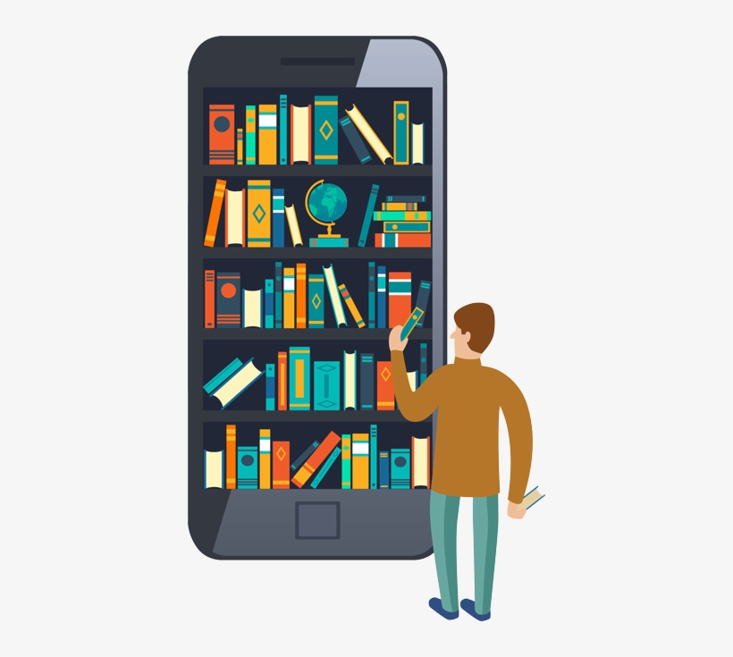
Digital Book Store
Our goal is to create a Digital Book Store, which allows Authors to sell their books directly to whomever want to buy a digital copy. This exchange will be saved in a decentralized distributed ledger.
All the money will go to the Author
Content will be available in all formats; eBooks and Audible books.

Slide 3
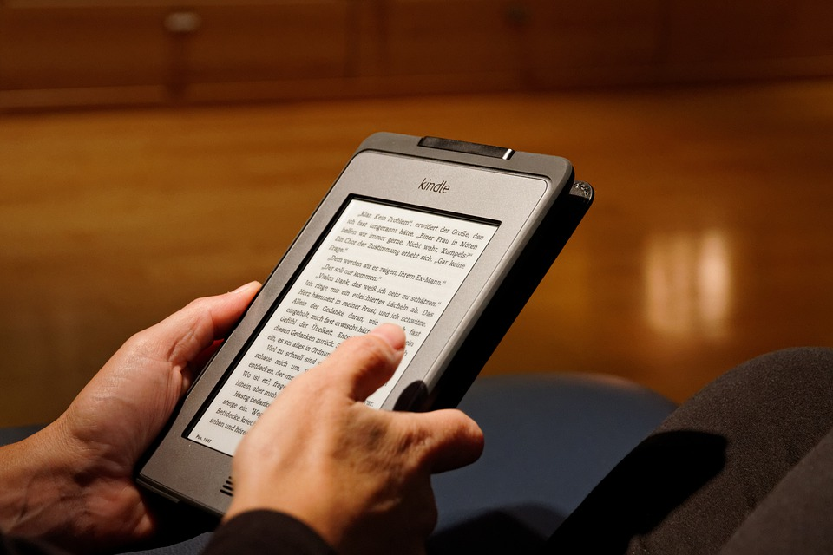
Decentralized Vs Centralized
The Centralized solution in this case rely on one individual to make decisions, provide direction, decide the prices, fees which will not be published.
The Decentralized solution will provide variety and autonomy.

Slide 4




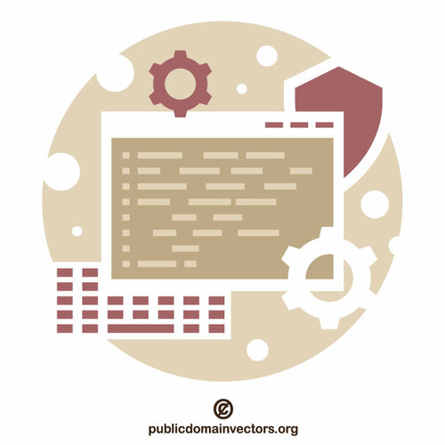
Advantages of the use case
maintain time and effort of the buyer and the seller
environmental benefits, it is friendly to the environment and trees
eliminates the problem of paper damage from long-term storage
accessible in any time from all over the world
keep up the pace with global digital development

Slide 5
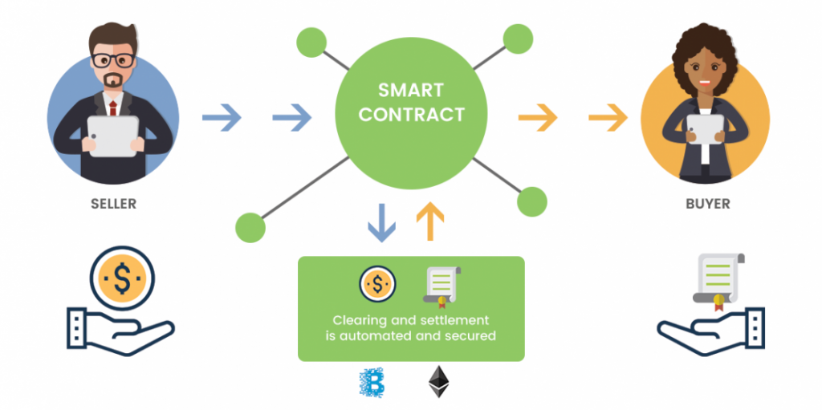
Smart Contracts

Slide 6
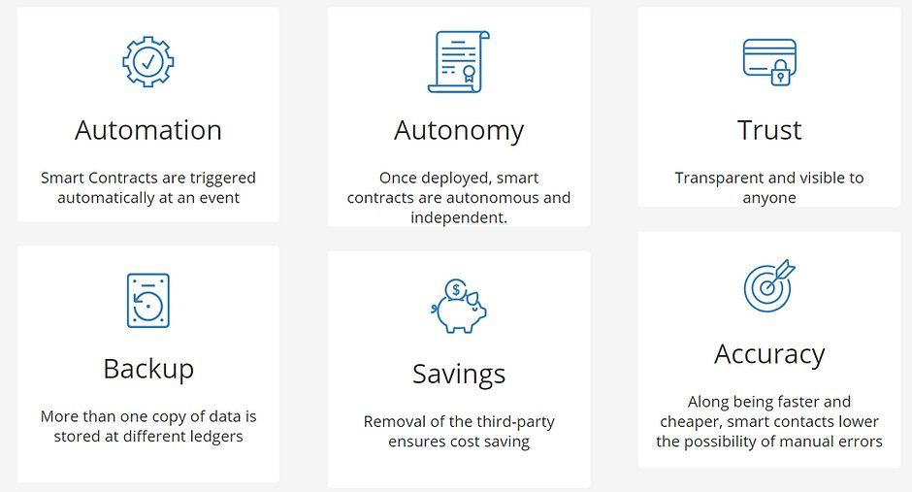
Benefits of Smart Contracts

Slide 7

Thank You.
Asma Harthi
Amal Alqahtani
Dhamya Alhemely
Haneen Abuallam
Khalid Alomari
Zainab Alharbi
resources:
Environmental Benefits Of E-books
Smart Contracts

